Slide 1
“…By this everyone will know that you are my disciples, if you love one another.” John 13:35
🔑 Message Series -
OVERALL QUESTION: What does Love “LOOK” like from the outside?
How will someone see that you “love one another”?
Today - # 3: Mature Love
Colossians 3 / Ephesians 4
👉 Get your Journal out or you phone to take notes!

Slide 2
Opening Prayer
Take us on a journey
Open our ears and hearts
Stop us from being offended
Convict us to align with you
Help us to grow!
Expand your kingdom, thy will be done!

Slide 3
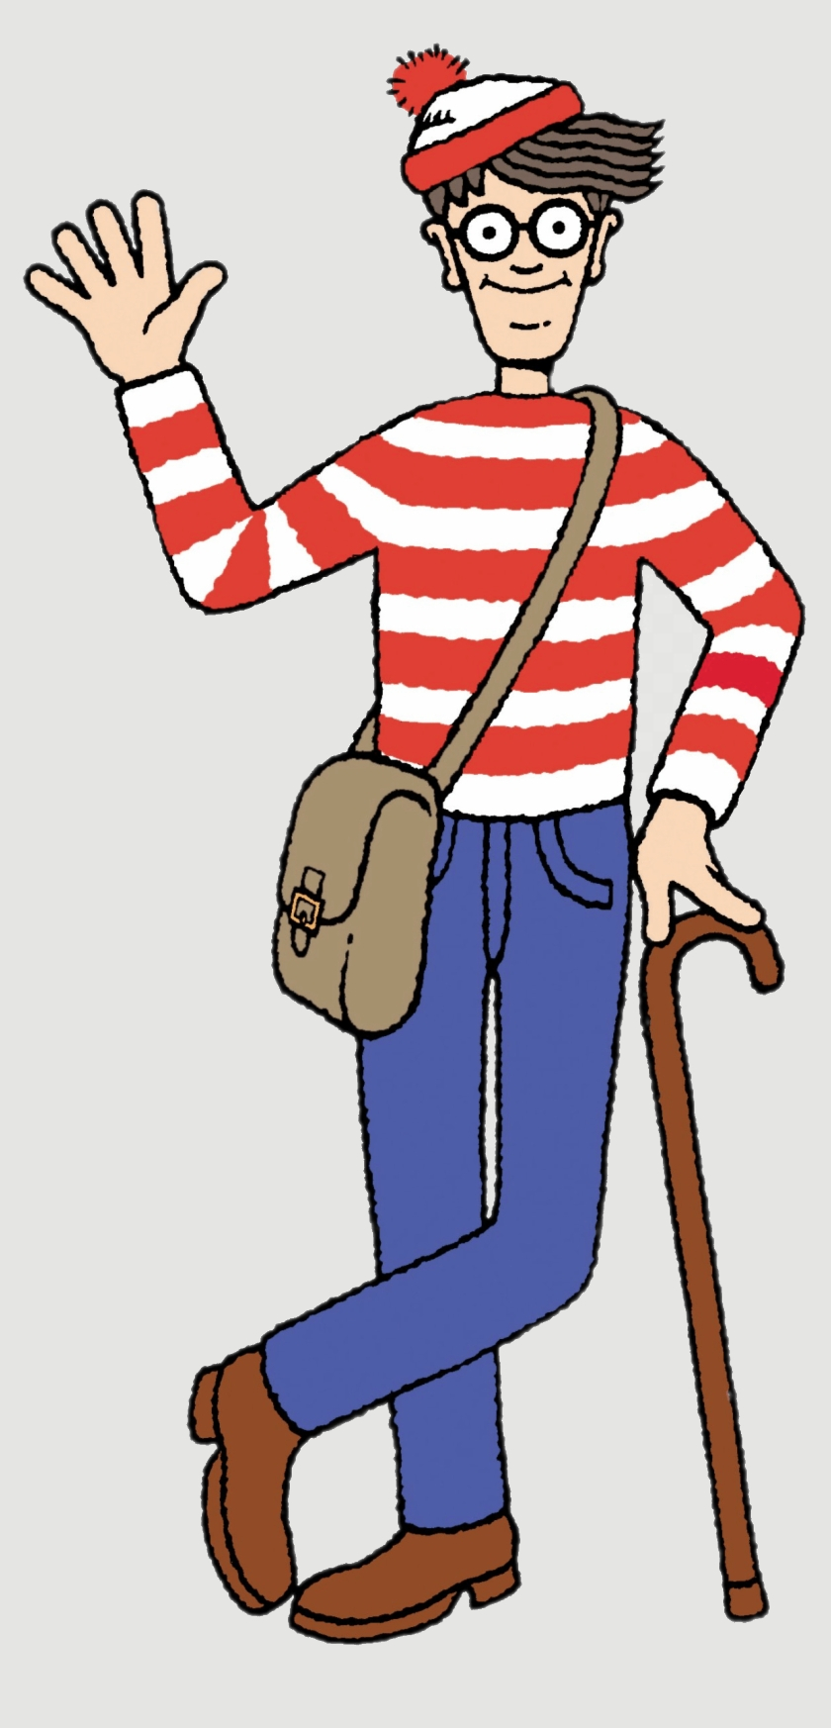
Every message in the Series will land the same way
Gospel, application, accountability.
A reference to Jesus and His good news
One clear practical application
One action to take this week
One person to share it with that was not here today
One close friend to spur you on and support each other in this task
Each will only help you grow stronger – no condemnation intended. (If you are struggling let me know.)
But… get comfortable with being uncomfortable
Love One Another | Forgiveness and Bearing with| Col 3/Eph 4

Slide 4
Review Previous Messages
Who can remember what they were about?
🐘

Slide 5
Review: Message 1 - Speech
Speech is a 2-Sided Coin: Heads - Build people up, Tails - Tame the tongue, stop gossip.
Every word you speak is either
building the ‘Church’...
or burning it down. (Eph 4/James 3)
Challenge: Have you started outdoing one another in giving others honour? (Rom 12)
Love One Another | Forgiveness and Bearing with| Col 3/Eph 4

Slide 6
Review: Message 2 Wise Love
Wise Love is a 2-Sided Coin: Heads – Carry your own Loads, Tails – Help Carry what is impossible for others to carry themselves (team sport).
“Don’t do for someone what God is expecting them to do!
But always help with what they cannot do alone.”
Challenge: Did you find one load to start carrying, one burden to help someone with, and someone to share this with? (Gal 6)
Love One Another | Forgiveness and Bearing with| Col 3/Eph 4

Slide 7
Something Beautiful is Happening!!!…
We were going to preach: Week 3 - “Serve One Another” Acts 2-4
But many of you… are just doing it!
People stepping in Helping quietly Checking on each other with
Practical care
  Meals
  Furniture
  Repairs
  Transport
  Support
  Encouragement
  Prayer
👉 That is what healthy love looks like Keep it up – OUT DO EACH OTHER -- “By this everyone will know…”
Love One Another | Forgiveness and Bearing with| Col 3/Eph 4

Slide 8
But…
As people get closer…
friction increases.
Real community is messy.
The closer the family,
the more opportunities for offence.
👉 Love is easy at a distance.
Love is tested up close.
As stated last time REAL LOVE COSTS!
8
Love One Another | Forgiveness and Bearing with| Col 3/Eph 4

Slide 9
Today: We Must Have Mature Love
The Three Coins
One truth – One coin with two sides
(In your small groups go over this again
SOS: Say Obey Share & Use Your Coin)
9
Love One Another | Forgiveness and Bearing with| Col 3/Eph 4

Slide 10
Forgiveness & Bearing With One Another
Colossians 3:12–14
Ephesians 4:31–32
“Love does not keep score.
Love absorbs cost.
Love chooses to preserve the relationship.”

Slide 11
Colossians 3:12-14
¹² Put on then, as God's chosen ones, holy and beloved, compassionate hearts, kindness, humility, meekness, and patience, ¹³ bearing with one another and, if one has a complaint against another, forgiving each other; as the Lord has forgiven you, so you also must forgive. ¹⁴ And above all these put on love, which binds everything together in perfect harmony.

Slide 12
Ephesians 4:31–32
³¹ Let all bitterness and wrath and anger and clamor and slander be put away from you, along with all malice. ³² Be kind to one another, tenderhearted, forgiving one another, as God in Christ forgave you.

Slide 13
One Coin – Mature Love - with Two Commands
Heads - Command 1
Tails - Command 2
Forgive Each Other
(Release / Cancel Debt / Reconciliation, Let Go)
But… Some people “forgive” but walk away from the relationship as it is just easier
Bear With Each Other
(Patience / Endurance / Long-suffering)
But… You can put up with someone without forgiving them!
Only together do they form mature love.
The Holy Spirit can help you pursue reconciliation where possible.

Slide 14
Heads: To Bear with One Another
Endures (Put up with) their weakness
Stays relational
Opens up conversation not shut it down
Helps them to grow in Christ
Model Assist Watch and Launch is discipleship. (MAWL)
First model what you want them to do!
Don’t quit quickly
Make room for immaturity
Remain patient
Bearing with weakness is not the same as tolerating ongoing destructive sin

Slide 15
Tails: Forgive One Another
Graciously Release debt
Refuse scorekeeping
Absorb cost
Cancel revenge
Let bitterness die. (It’s a pill that will only kill you.)
Forgiveness is an ongoing choice not a feeling or eliminating the problem by walking away!
👉 “Love absorbs the cost instead of keeping score.”

Slide 16
Best Example: Good News of Jesus Christ
For all have sinned and fallen short of the glory of God. (Rom 3:23)
For the wages of sin is death, but the free gift of God is eternal life in Christ Jesus our Lord. (Rom 6:23)
…but God shows his love for us in that while we were still sinners, Christ died for us. (Rom 5:8)
Here’s the catch….
Col 3:12 & Eph 4:32
“As the Lord forgave you, so you also must forgive!”

Slide 17
You offended God infinitely more than anyone has offended you.
Yet Christ:
  Moved toward you
  Absorbed your debt
  Paid your cost
  Offered reconciliation (a way back to God)
👉 The cross is forgiveness with nails in it.

Slide 18
As stated, Real Love always costs you something
The three coins…
Why is money valuable?
Because someone absorbs the cost.
A shiny coin fresh from the mint has never been through circulation.
But a worn coin?
That coin has bumped into thousands of other coins.
Handled. Scratched. Slightly Bent. Dented. Dropped. Lost and found.
Yet it still has value!

Slide 19
Christian community is like that
If you stay close to people long enough, there will be friction.
Churches are full of broken sinful people. That includes you and me! (“Stuck in Traffic”)
But mature love does not throw people away because of scratches and dents.

Slide 20
As people get closer…
friction increases.
Real community is messy.
The closer the family,
the more opportunities for offence.
👉 Love is easy at a distance.
Love is tested up close.

Slide 21
These verses assume:
People will -
  annoy you
  Misunderstand you
  Fail you
  Disappoint you
  Sometimes wound you
  👉 Friction is not proof love failed.
  It is proof people are involved.

Slide 22
Two real coins… and one counterfeit.
Some relationships look like love
on the outside…
…but are counterfeit underneath.
🙂 Smiling outwardly
😠 Bitter inwardly
🤝 Polite publicly
🗣 Gossip privately
🕊 Avoiding conflict
❄ Building distance
👉 Fake peace is not real peace.
Real love forgives honestly.

Slide 23
The Danger
Unresolved Offence Becomes Poison
Small offences become:
Bitterness
Distance
Coldness
Suspicion
Gossip
Division
Many churches do not explode overnight.
They slowly freeze.
“Mature love deals with wounds —
it does not hide them.”

Slide 24
Forgiveness Is NOT:
Pretending nothing happened
Calling evil good
Avoiding healthy boundaries
Instant trust restoration
Excusing abuse or sin
Enabling people to continue to sin or not grow in Christ.
👉 Forgiveness releases revenge.
It hands judgment to God.

Slide 25
Forgiveness and Reconciliation Are Not Always the Same
Forgiveness can happen in the heart immediately.
But reconciliation requires:
Repentance
Truth
Safety
Trust rebuilding
Change over time
Some relationships become healthy again.
Some require distance, boundaries,
or leadership involvement.
👉 Forgiveness releases revenge. Wisdom determines access.

Slide 26
What Love Does
Love Absorbs Cost
Forgiveness always costs someone.
Jesus absorbed OUR debt.
Now we are called to:
Absorb offence
Release bitterness
Refuse scorekeeping
👉 “Love keeps no record of wrongs.”
(1 Corinthians 13)

Slide 27
Keeping it Real: Some People Are Hard To Love
Some are immature, regardless of their actual age
Some are wounded
Some are exhausting
Some repeatedly fail (As I do! I’m just better at hiding it.)
And yet…
God has had to “bear with” us too.
👉 Humility changes everything.

Slide 28
“For if you love those who love you, what reward do you have? Do not even the tax collectors do the same?
And if you greet only your brothers, what more are you doing than others? Do not even the Gentiles do the same?” (Matt 5:46-48)
I want to say: ‘Take a teaspoon of cement and harden up’ but my wife tells me I can’t say that.
Not every discomfort is a crisis. Sometimes we need support. Sometimes we need resilience. Ask for both! (In prayer and from your brothers and sisters.)
Start being self-aware, look at yourself as others may see you. Continue to grow and become more like Christ so you are easier to love and have the capacity to love others more.
👉 Forgiven people learn to forgive people. To bear with others as God bears with you.

Slide 29
What does the scriptures mean by ‘offense’?
Many churches confuse:
discomfort
personality clash
preference disagreement
conviction
immaturity
Disagreement with Hate Speech
actual sin/abuse
…and treat them all equally.
That creates either:
  hypersensitive churches
  OR
  abusive churches.
We are aiming for mature discerning love.

Slide 30
Scratch or Wound? (This is NOT two sides of a coin!)
Some things are:
Scratches
Just irritating friction
Others are:
Wounds
(real sin/damage)
Both matter…
but they are handled differently.

Slide 31
Scratches (“Bear With One Another”)
These are usually:
personality friction
preferences
immaturity
misunderstandings
annoyances
style differences
These require:
Patience
Humility
Conversation
Perspective
Grace

Slide 32
Examples of “Scratches”
Preferences
“They changed the music.”
“I don’t like that style.”
Personality
“They are loud/blunt/quiet/emotional.”
“They were insensitive.”
Minor Social Friction
“They forgot to include me.”
“They interrupted me.”
“They didn’t say hello.”
Ministry Differences
“They organise differently than me.”
“They lead differently than I would.”
“I don’t like the songs”
Maturity Differences
“They are still growing.”
“They say awkward things sometimes.”
👉 These are usually “bear with one another” moments.

Slide 33
Wounds (“Forgive / Confront / Protect”)
These involve:
real sin
damage
abuse
betrayal
destruction
ongoing unrepentance
These require:
Truth
Repentance
Forgiveness
Sometimes boundaries
Sometimes leadership involvement

Slide 34
Examples of Real Wounds
Hate Speech / Slander
Public humiliation
Racist abuse
Malicious gossip
Character assassination
Betrayal
Affair
Deep deception
Financial dishonesty
Abuse
Manipulation
Control
Spiritual intimidation
Violence
Predatory behaviour
Ongoing Destructive Sin
Repeated unrepentant behaviour harming others
Serious Division
Deliberately splitting relationships
Creating factions
👉 These are NOT “just bear with it” situations.

Slide 35
Very Important Distinction
“Not every irritation is abuse.
But not every wound is merely irritation either.”
Balance and wisdom are gained during our walk with God.
“Love covers many irritations… but love does not protect evil.”
“Some things require patience. Some things require repentance.”

Slide 36
Before Acting, Ask Yourself:
Side | Theme | Question
Bear With | Daily friction | “Will I stay?”
Forgive | Real wounds | “Will I release?”
Lord, what does love require here?

Slide 37
One Pastoral Warning
Some Christians misuse:
“Bear with one another” …to silence wounded people.
Paul NEVER meant:
  tolerate abuse
  ignore evil
  protect predators
  avoid accountability
Biblical love includes:
  truth
  safety
  repentance
  restoration
  Wisdom &
  GRACE

Slide 38
Practical Grid For Your Guidance
Situation | Mostly “Bear With”? | Needs Confrontation?
Different personality | YES | Usually no
Awkward social moment | YES | Usually no
Ministry preference | YES | Usually no
Immaturity | YES | Sometimes gentle correction
Gossip | NO | YES
Slander | NO | YES
Manipulation | NO | YES
Abuse | NO | YES immediately
Racism/hate speech | NO | YES
Adultery/deception | NO | YES

Slide 39
The Two Extremes to Avoid
Ditch 1 — Avoidance
Withdraw
Ghost people
Stay offended
Silent punishment
Ditch 2 — Fake Peace
Smile outwardly
Resent inwardly
Never address issues honestly
👉 Biblical love tells the truth WITH grace.

Slide 40
“Practical Wisdom”
How To Bear With One Another:
Slow down
Ask questions first
Assume less
Listen longer
Pray before reacting
Speak privately first (Matt 18)
Refuse gossip – (talking about or listening to)
👉 Most conflict grows in the dark.

Slide 41
Diagnostic Questions
Who am I still holding?
Who do I avoid?
Whose name changes my attitude immediately?
What offence am I replaying?
Have I asked God to forgive me more than this?

Slide 42
Call to Action This Week
Pray for one person you struggle with;
Refuse gossip or scorekeeping;
Start one hard conversation gently;
Release one offence to God.
And:
Who will you share this with
that was not here today?
Who will ask you if you did it?

Slide 43
Conclusion
Mature love:
Stays soft
Tells the truth
Lets go of bitterness
Keeps showing up
👉 “Bear with one another… forgive one another… and above all these put on love.”
“Bearing with, can give relationships room to grow. Forgiveness, heals the relationship when it is wounded.”

Slide 44
🎯 Prayer:
“Lord, teach us to love each other like You loved us.”

